Slide 1
Introduction to Credit

Slide 2
Discussion Prompts
Have you ever borrowed from or lent money to someone?
Who did the loan involve?
What was the agreement for repayment?
Did it work out the way you anticipated?
Were both people happy at the end?

Slide 3
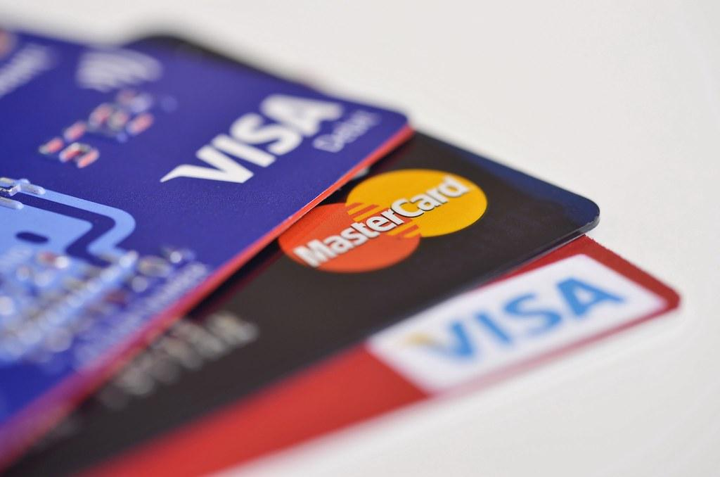
What is Credit?
The ability of a customer to obtain goods or services before payment, based on the trust that payment will be made in the future.

Slide 4
What is Debt?
Debt is an amount of money borrowed by one party from another. Debt is used by many corporations and individuals as a method of making large purchases that they could not afford under normal circumstances.

Slide 5
Difference Between Credit and Debt
Credit is as “a method of paying for goods at a later time, usually paying interest as well as the original money.” Debt is simply “the amount of money you owe to someone else.”

Slide 6
Good Debt vs. Bad Debt
Is there such a thing as Good Debt or Bad Debt?
Please read the article below individually and discuss as a class….
Good Debt vs. Bad Debt: What is the Difference?

Slide 7
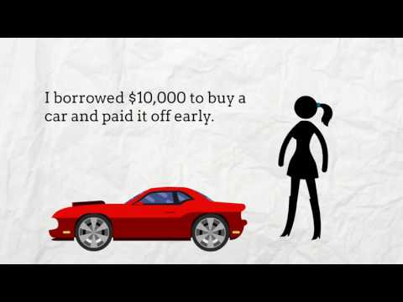
What is credit?
Where will we use credit in our lives?
Is credit good? Or bad?
When should you use credit?
When shouldn’t you use credit?
How would you summarize what credit is?

Slide 8
Using Credit
ADVANTAGES
Able to buy needed items now
Don’t have to carry cash
Creates a record of purchases
More convenient than writing cheques
Consolidates bills into one payment
Emergencies
Rewards programs
DISADVANTAGES
Interest (higher cost of items)
May require additional fees
Financial difficulties may arise if one loses track of how much has been spent each month
Increased impulse buying may occur
Future income tied to past debts
May have less available credit for unforeseen emergencies

Slide 9
Loan Basics
Define principal, interest, & term.
What are the main advantages of a secured and unsecured loan?
Secured --
Unsecured --
List two examples of items that could be used as collateral for a secured loan.
What factors determine the interest rate that will be charged for money borrowed when using credit?
What is a cosigner and what considerations should they make before co-signing a loan?
What is a danger of taking a variable rate loan?

Slide 10
Types and Sources of Credit
Single Payment Credit
Items and services are paid for in a single payment, within a given time period, after the purchase. Interest is usually not charged.
Utility companies, medical services, some retail businesses
Instalment Credit
Merchandise and services are paid for in two or more regularly scheduled payments of a set amount. Interest is included. A repayment plan is drawn up in the form of a conditional sales contract based upon fulfilling a number of conditions of the contract.
Some retail businesses, such as car and appliance dealers

Slide 11
Types and Sources of Credit
Consumer Loans
Money may also be loaned for a special purpose, with the consumer agreeing to repay the debt in regularly scheduled payments.
Chartered banks, consumer finance companies, credit unions, trust companies
Revolving Credit
Many items can be bought using this plan as long as the total amount does not go over the credit user’s assigned dollar limit. Repayment is made at regular time intervals for any amount at or above the minimum required amount. Interest is charged on the remaining balance.
Retail stores, financial institutions that issue credit cards

Slide 12
5 C’s of Credit
Character
Capacity
Collateral
Conditions
Capital

Slide 13
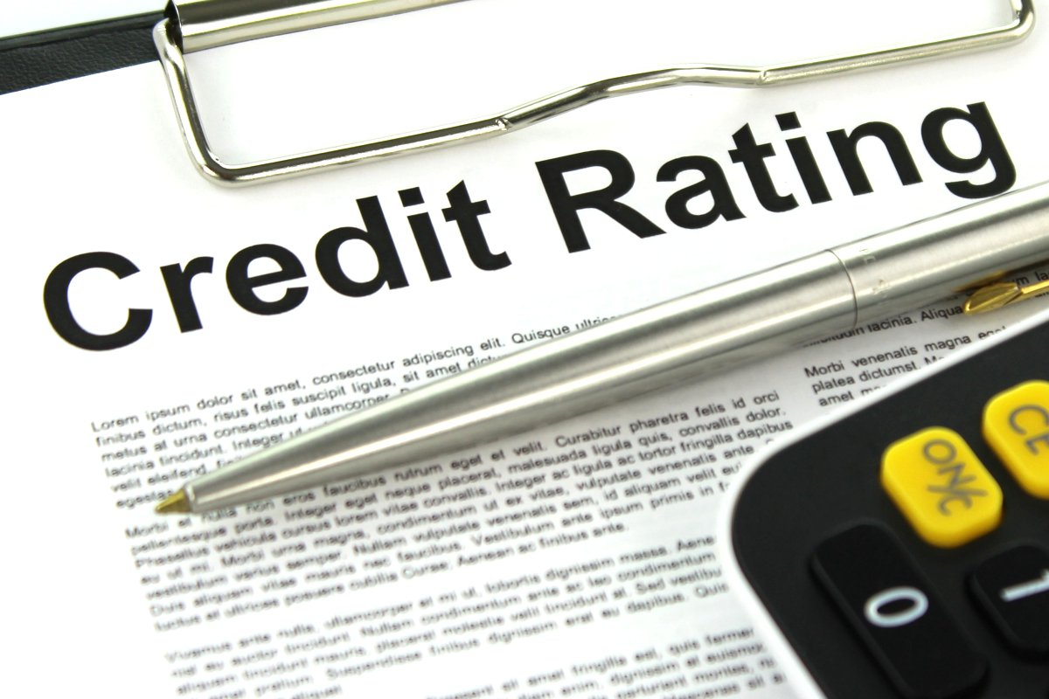
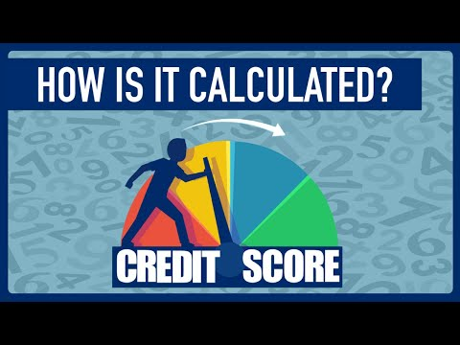
Credit Rating/Credit Score

Slide 14
How to Check Your Credit Score?

Slide 15
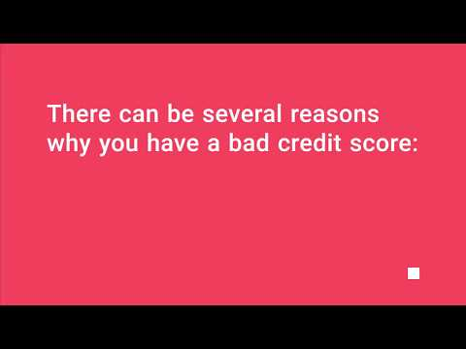
Consequences of a Bad Credit Score?

Slide 16
Activity: Categorizing Credit

